Slide 1

WALMART
SQL PROJECT

Slide 2


Agenda
A
1. Introduction
2. Questionaries
3. Query
4. Result Grid
5. Summary

Slide 3
Introduction
WALMART engages in retail and wholesale business. The company offers an assortment of merchandise and services at everyday low prices

Slide 4
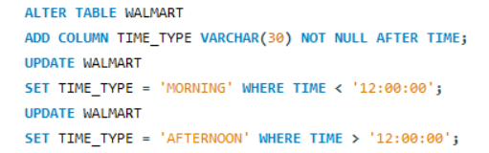

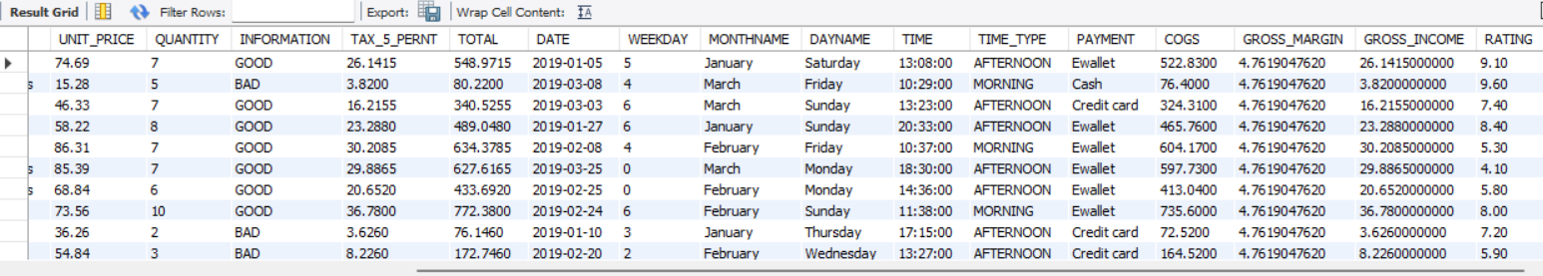
QUESTION NO. 1
UPDATE TIME INTO MORNING AND AFTERNOON

Slide 5
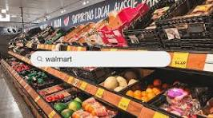

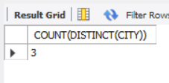
QUESTION NO. 2
HOW MANY UNIQUE CITIES DOES THE DATA HAVE?

Slide 6
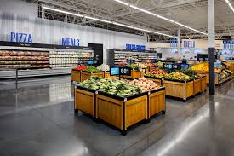
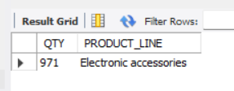
Which is the most selling product line?
QUESTION NO. 3

Slide 7
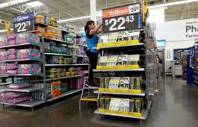
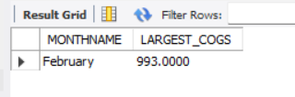
QUESTION NO. 4
WHICH MONTH HAD THE LARGEST COGS?

Slide 8

QUESTION NO. 5
WHICH IS THE CITY WITH THE LARGEST REVENUE?

Slide 9
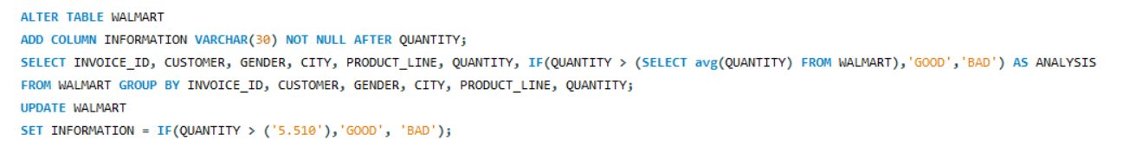
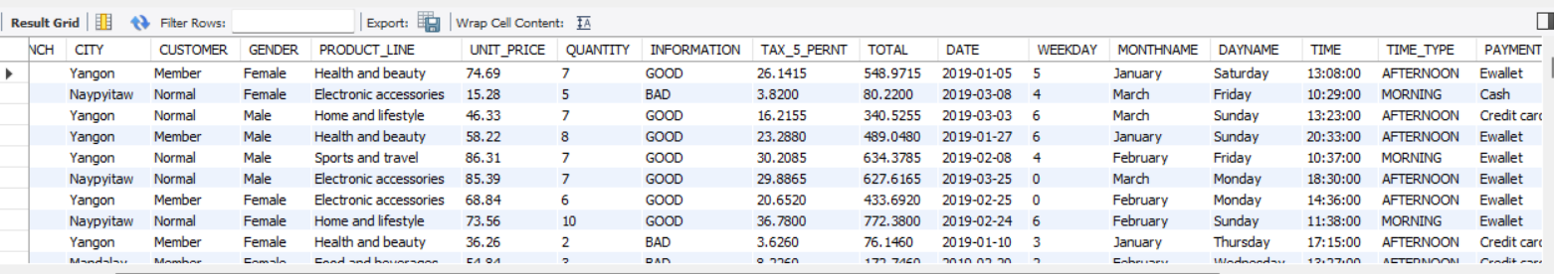
QUESTION NO. 6
Fetch each product line and add a column to those product line showing "Good", "Bad". Good if its greater than average sales
F

Slide 10
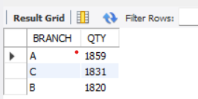
QUESTION NO. 7
Which branch sold more products than average product sold?

Slide 11
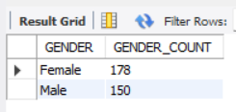
QUESTION NO. 8
What is the gender distribution per branch?

Slide 12
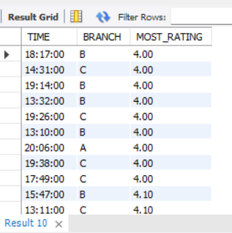
QUESTION NO. 9
Which time of the day do customers give most ratings per branch?

Slide 13
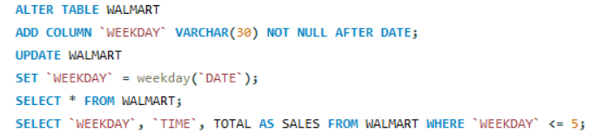
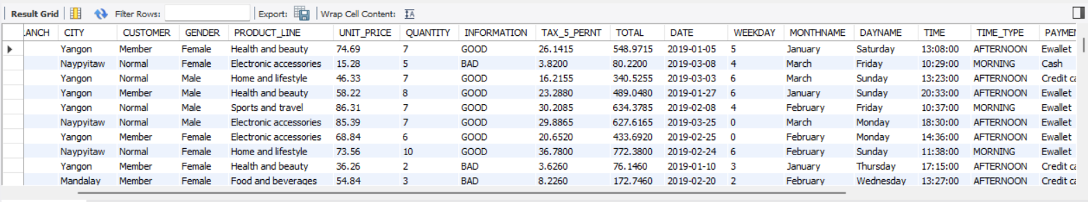
QUESTION NO. 10
Number of sales made in each time of the day per weekday

Slide 14
Summary
WALMART is the World’s Largest Company By Revenue

Slide 15
Thank you
JAIMIN SHAH
jaiminshah@yahoo.com
8200725322
7490845884

